Slide 1


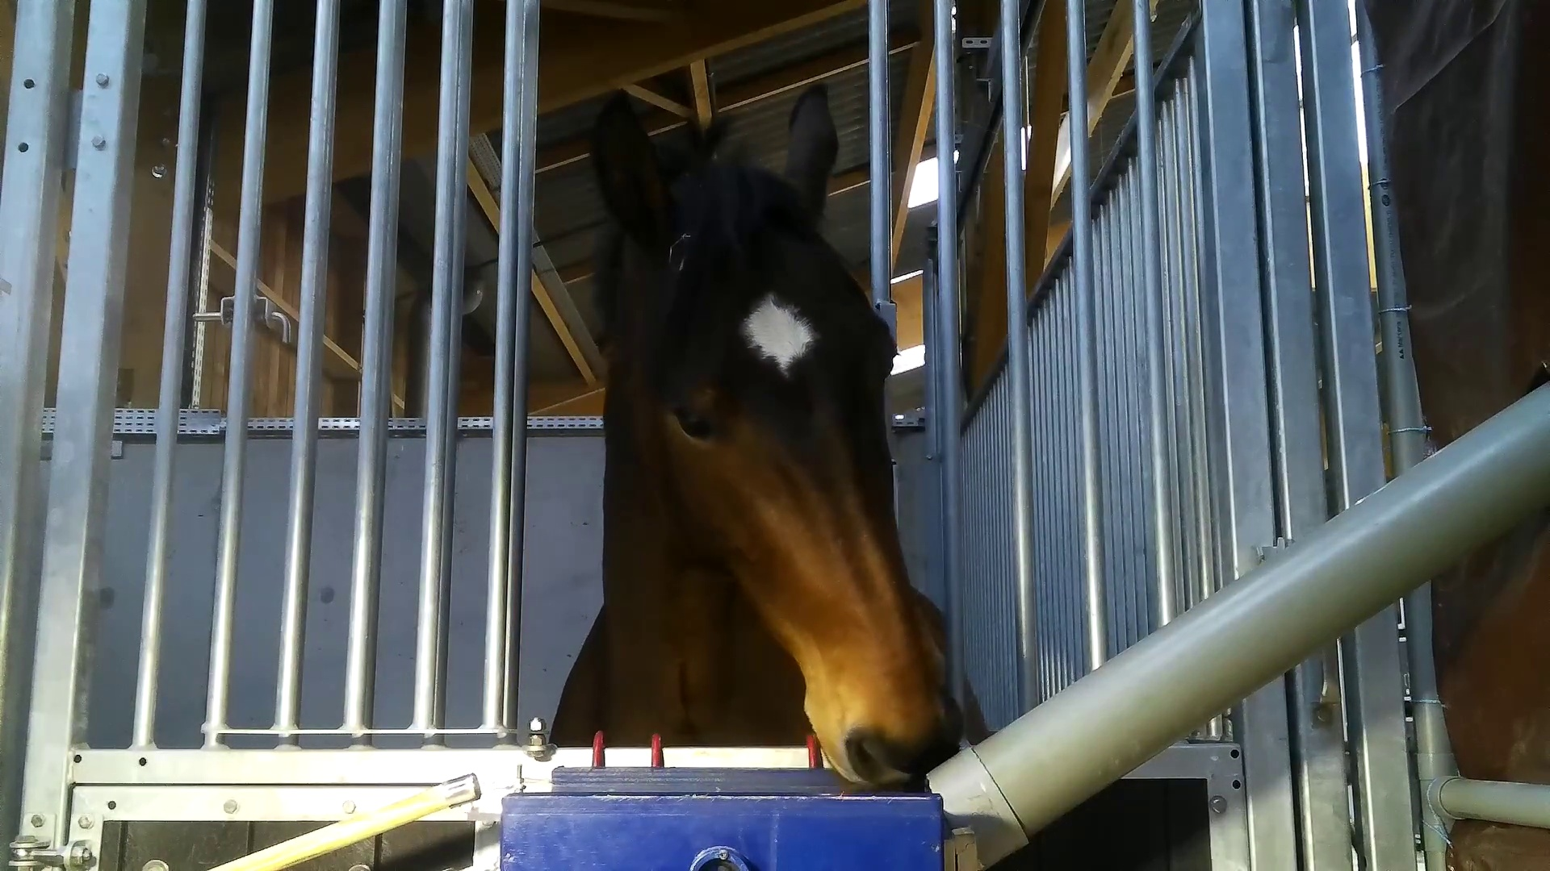
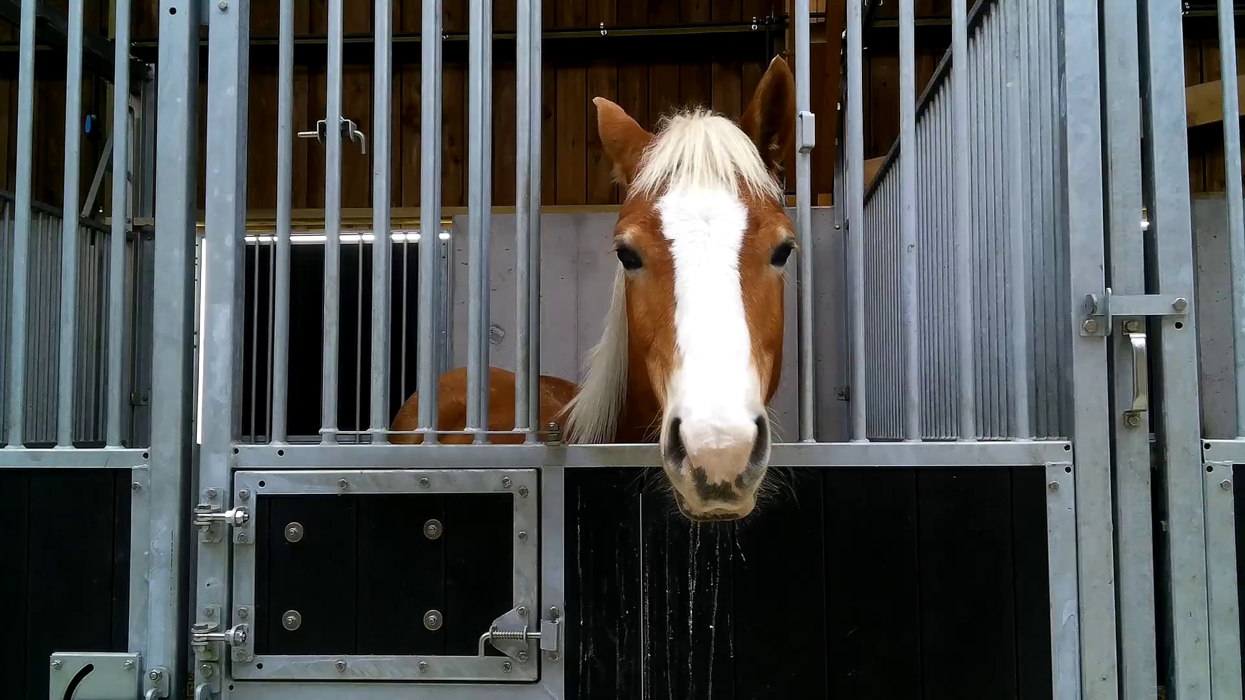
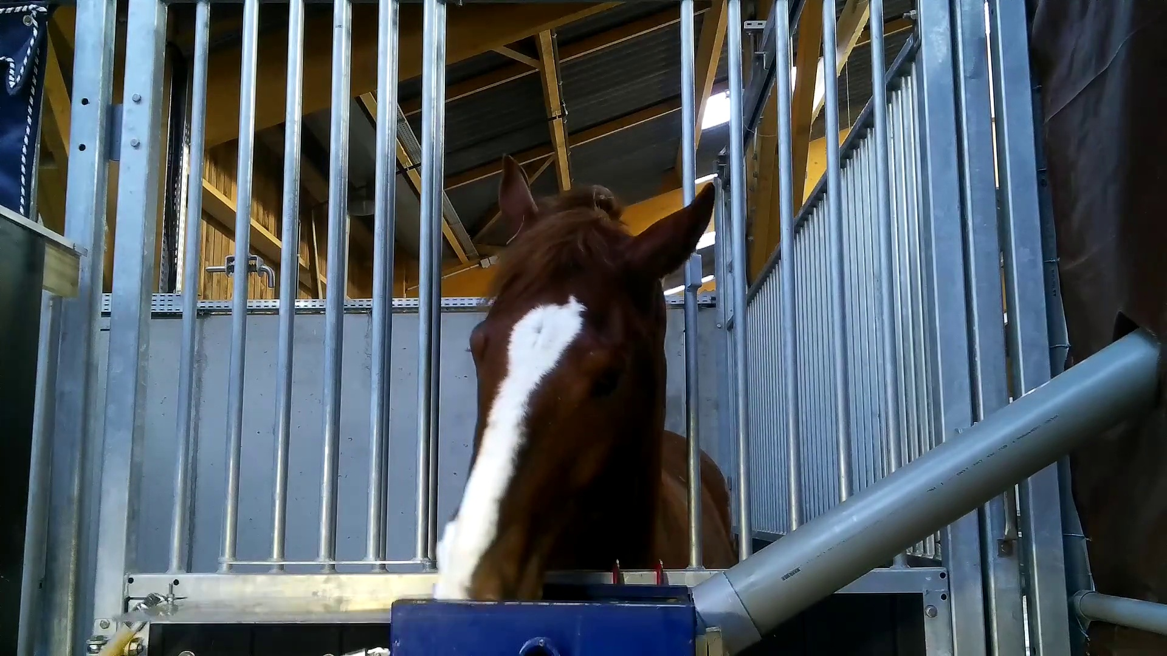
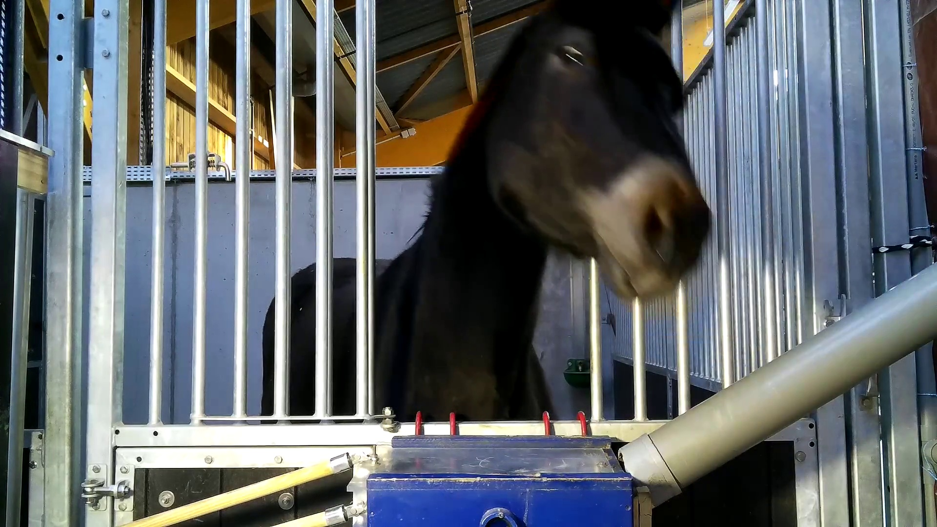
Horse Emotion Classification from Videos
Hana Hasan, Hallel Weinberg, Tidhar Rettig
Supervisors: Marcelo Feighelstein and Dr. Anna Zamansky
Baseline
Disappointment
Frustration
Anticipation

Slide 2
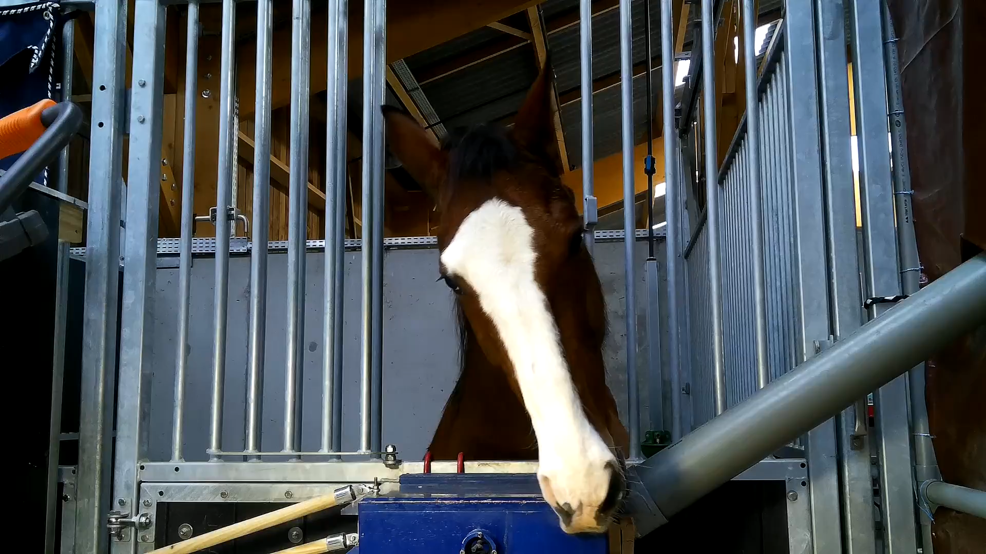
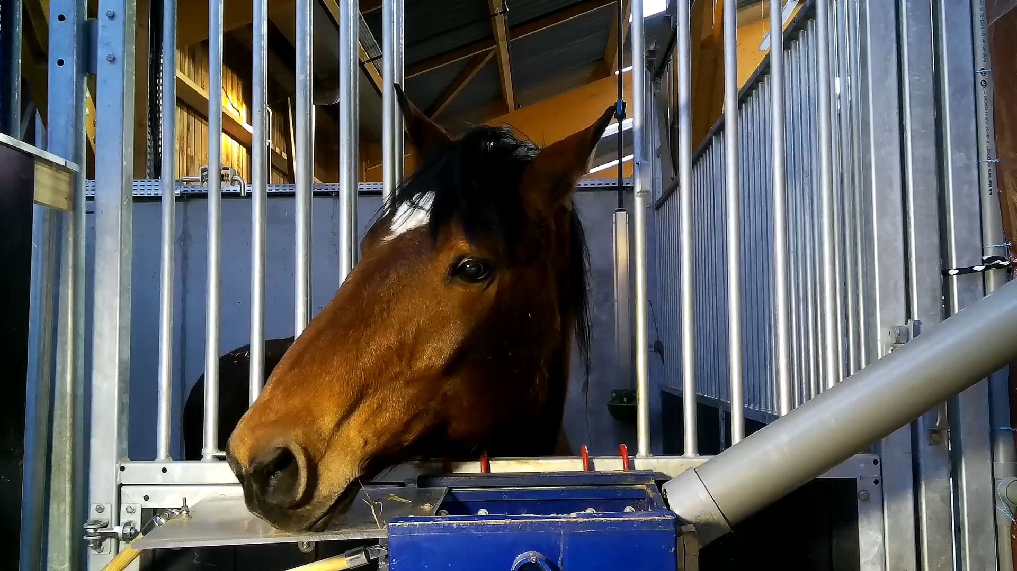
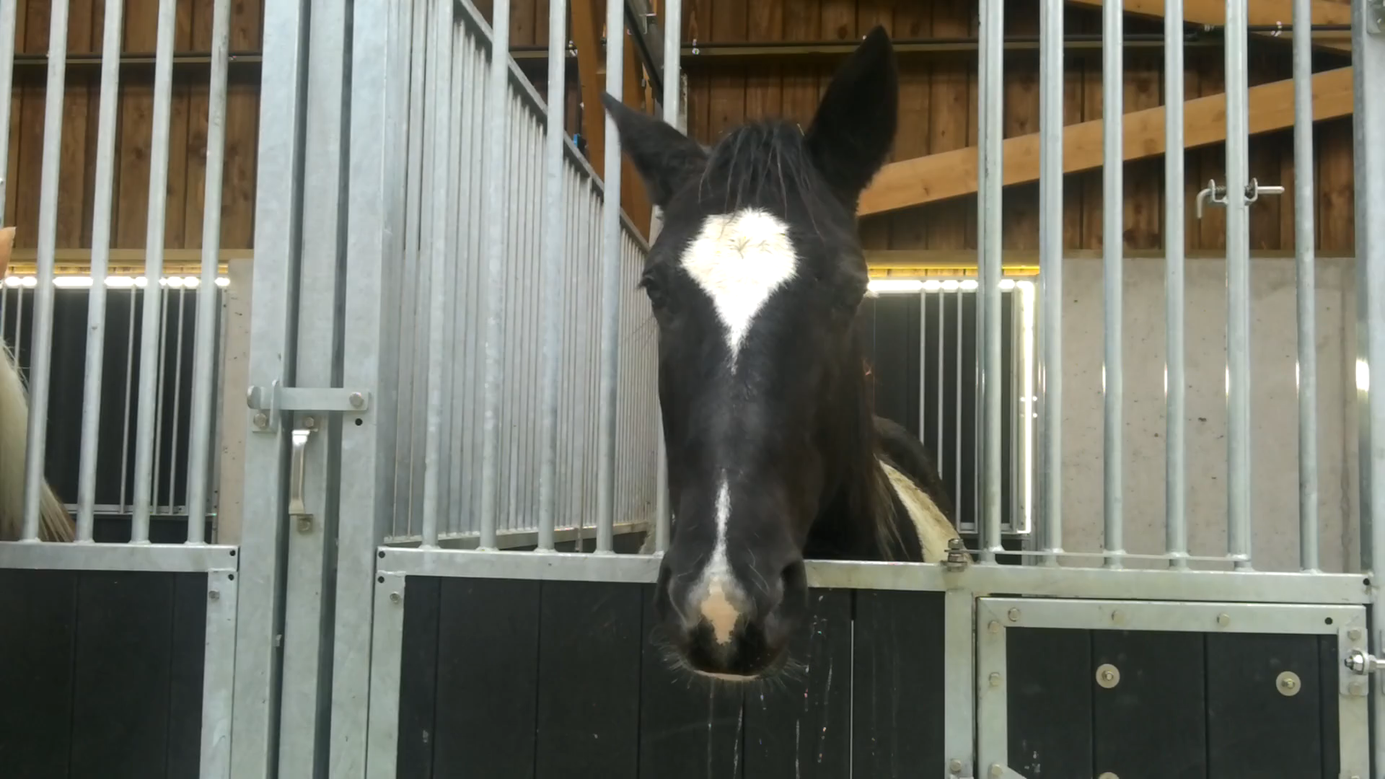
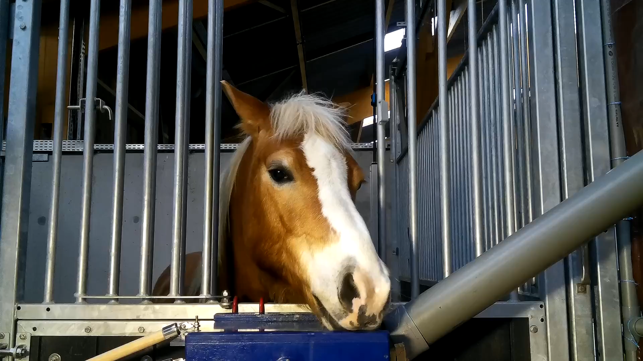
Data
A controlled experiment was conducted to acquire data.
The data consists of short videos of 30 horses.
Each video has a duration of approximately 3 seconds.
Emotion labeling was done for each video, with 4 different emotions.
The number of videos labeled with each emotion are as follows:
Anticipation: 87 videos
Baseline: 30 videos
Disappointment: 90 videos
Frustration: 89 videos

Slide 3
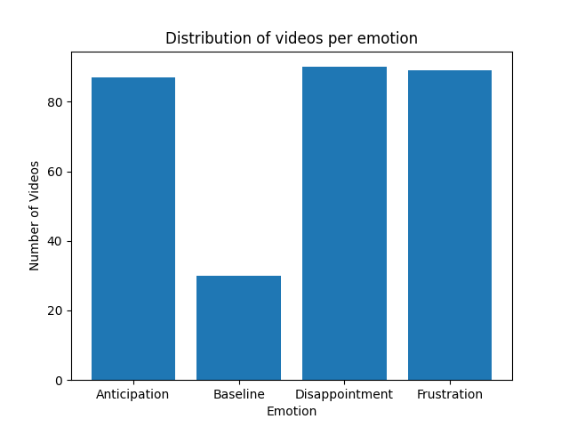
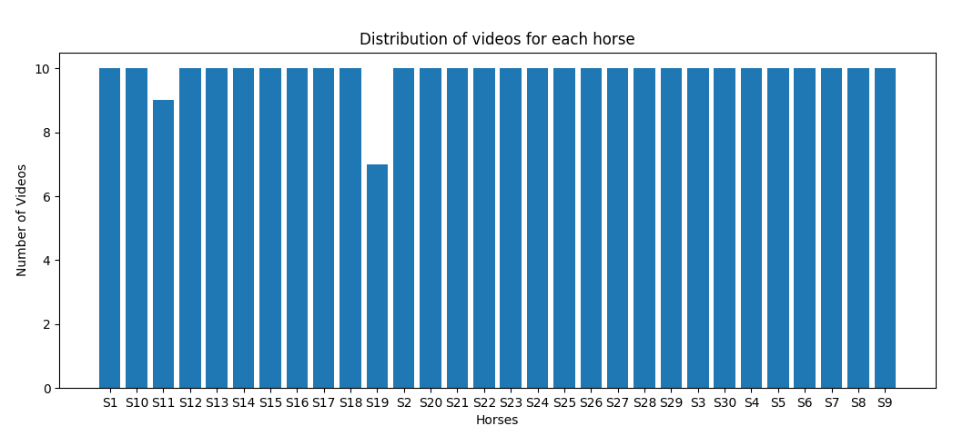
Data

Slide 4
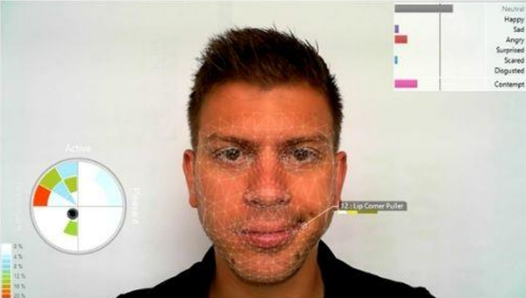
Motivation
Train an emotional state classification model
Predict emotional state for video samples
Visualize emotional states predictions
(4-classes emotion with confidence level)

Slide 5
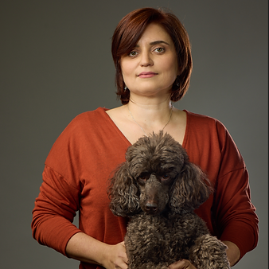

Our Work
November 2022: Finding our AWESOME supervisors!
Reaching out to Dr. Anna Zamansky, the head of Tech4Animals lab and Associate Professor at the Information Systems Department.
We were fortunate to be assigned to the horse emotion classification project under the direct supervision of the PhD candidate Marcelo Feighelstein.

Slide 6

Our Work
December 2022: Getting Started…
We began working on the project by familiarizing ourselves with the data and the work plan.
We also had to learn about the relevant libraries and techniques in Python for handling images, including OpenCV and PIL.
Additionally, we were given access to “PyImageSearch” to learn about deep learning and computer vision. We were taking the “Image Processing” course with Hagit as well.

Slide 7
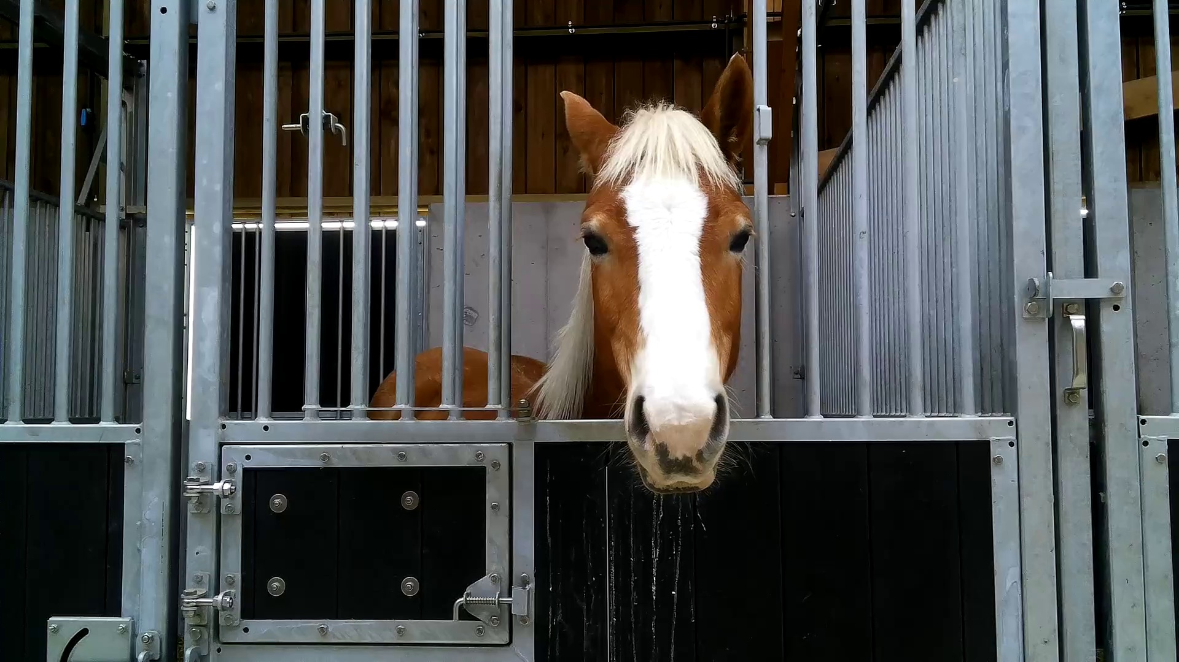
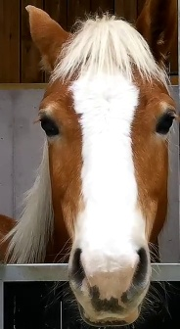
Our Work – Preprocessing
Motivation:
The original video frames contain background clutter.
We aim to focus on the facial expressions of the horses and avoid learning other emotional state predictors (e.g. horse body postures).
Work Plan:
Crop the facial bounding box from each image.

Slide 8
Our Work
January-March 2023: Trying different things
Breaking the videos into frames, which resulted in approximately 179 frames per video
Why? We will be working with a dataset of images (frames),
which can be handled either as (i) single frames or as (ii) a sequence of frames. Based on previous work at the Tech4Animals lab, we found that the prevalent approach in the context of automated recognition of emotional states and pain in animals is the single-frame basis.
We assume that the frames can capture information on the emotional state of the horses effectively.
Therefore, we decided to extract single frames from the videos and label them accordingly to create our final dataset.

Slide 9
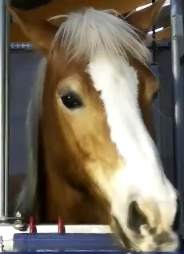
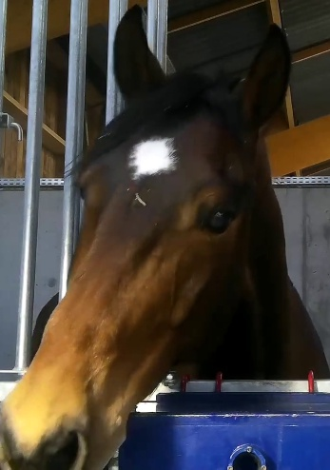
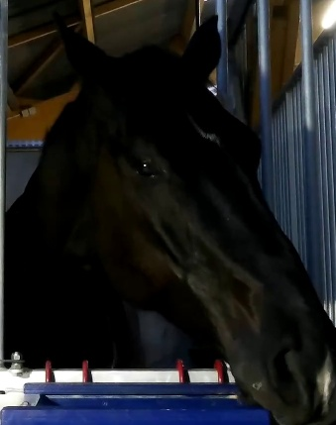
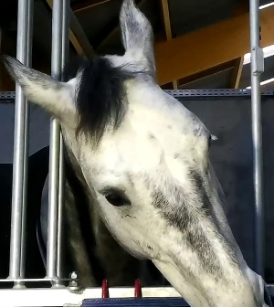
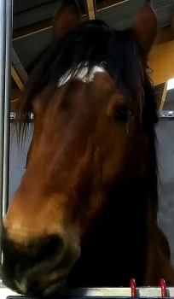
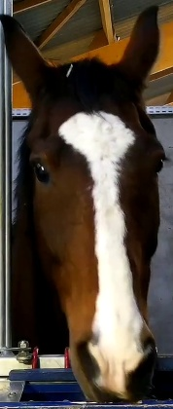
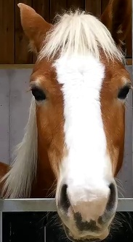
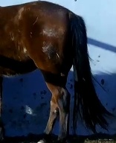
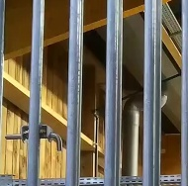
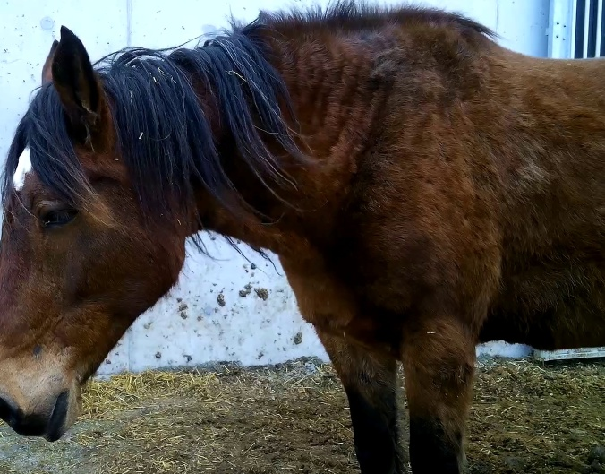
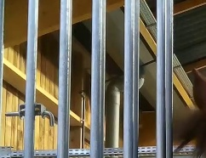
Our Work
A failed attempt to build a face detector via pre-trained YOLO
Why YOLO? because of its effectiveness in object detection tasks and because it had been trained on a horse dataset.
Worked phenomenally on some images:
But no so well on others…

Slide 10
Our Work
Another failed attempt to build a face detector via center cropping
Why center crop? We noticed that in the (majority of) frames, horse’s head is in the middle.
This approach also turned out to be problematic because in some frames, it caused us to miss a part of the horse’s face. Therefore, this approach was not successful either.

Slide 11
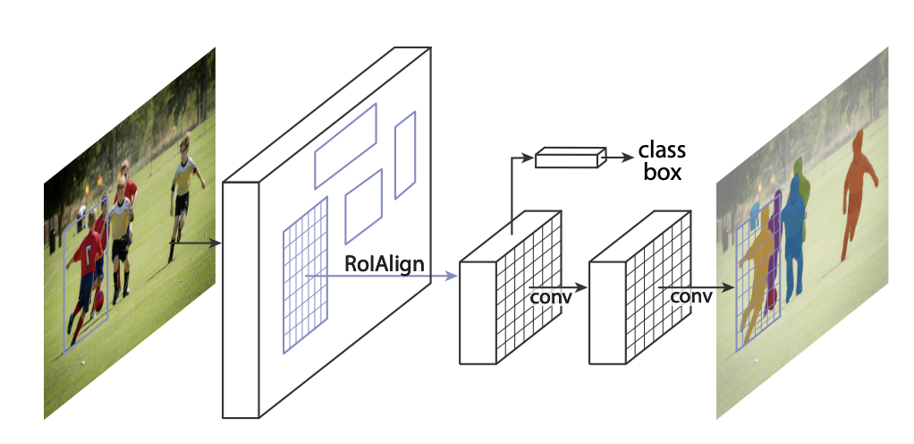
Our Work
Conclusion: We need to train a Mask-RCNN to obtain facial crops
Why Mask-RCNN? because it is a powerful instance segmentation model.
Problem: We need to annotate a couple of hundreds of images.

Slide 12
Our Work – Building a Classifier
To train a model for classifying the emotional state of horses, we adopt a transfer learning approach that utilizes the learned features of a pre-trained model to build a new model for this specific task.
Specifically, we use a the ConvNet as a fixed feature extractor, where we freeze all the layers except for the final one.
This allows us to utilize the learned features of the pre-trained model while only training the final layer for our specific classification task, preventing any backpropagation through the pre-trained layers.

Slide 13
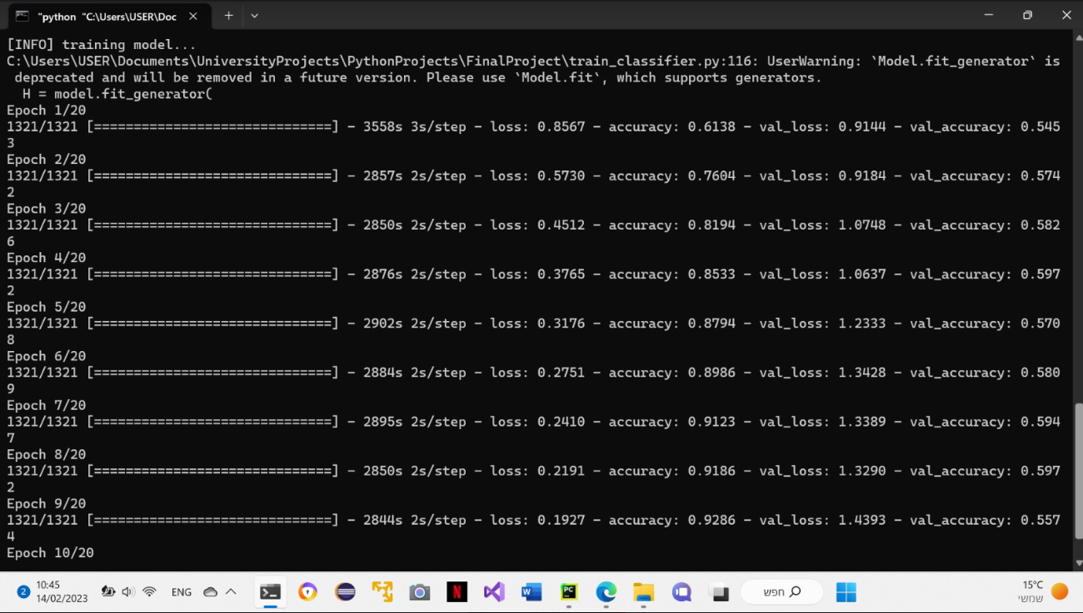
Our Work
First Attempt: fine-tuning ResNet50 in Keras, Tensoflow
Long time to train.
Bad accuracy.
Many functions
being deprecated.
Hyperparameters
choice gone wrong.
Learning rate scheduler
and saving the best model
did not work.
Overall: BAD

Slide 14
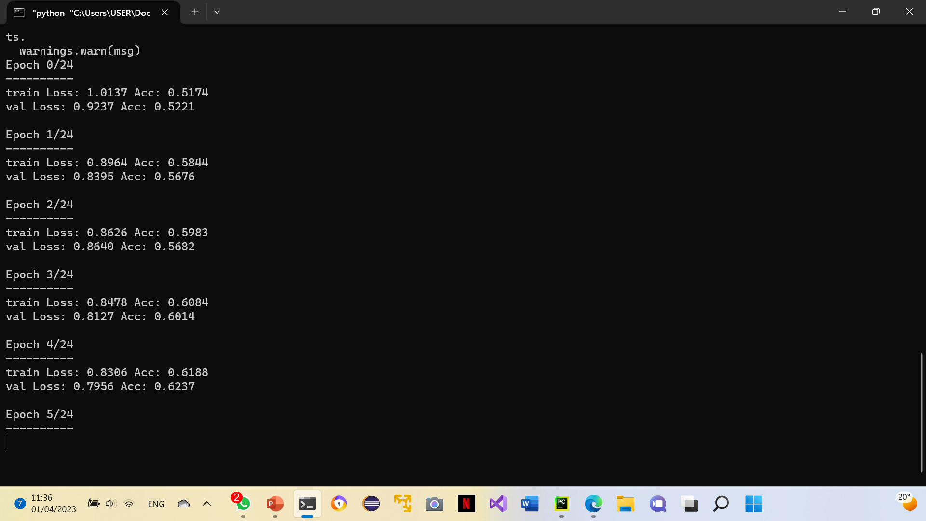
Our Work
Second Attempt: transfer learning, ResNet50, PyTorch
PyTorch was easier to use.
Takes even longer to train.

Slide 15
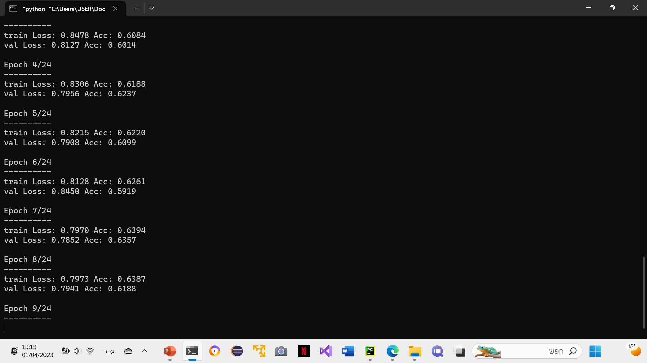

Slide 16

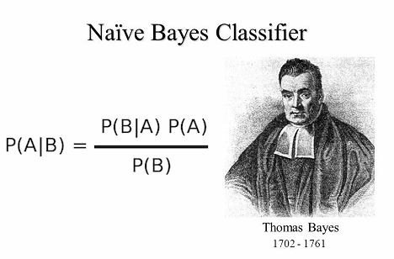
Our Work
Extracting Image Embeddings with Pre-Trained Models
To overcome our computational resource limitations, we can utilize a pre-trained model to extract vector embeddings of images. Then, we can use a traditional machine learning algorithm, such as Random Forest, to perform the classification task.
The Naïve-Bayes approach will also be examined.

Slide 17
Additional Preprocessing
Filtering/Pre-processing:
For each video select top 20 frames with maximal confidence on ground truth emotion of the video.
3 scenarios:
Take all frames in train and test.
Filter on test and train.
Filter inly on train.

Slide 18
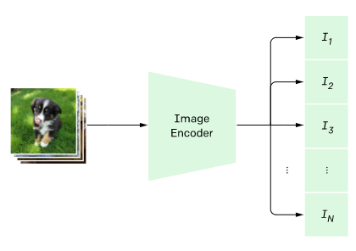
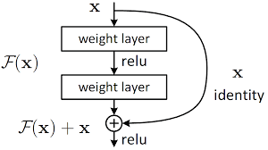
Different Backbones
We explore the suitability of different backbones for this task. To do so, we conduct experiments using two different pre-trained backbones:
ResNet50 and CLIP Image Encoder.
ResNet50 is a widely used deep convolutional neural network that has demonstrated high accuracy in image classification tasks.
On the other hand, CLIP Image Encoder is a more recent pre-trained model that uses a transformer architecture and has demonstrated superior performance in image classification tasks when compared to other pre-trained models.

Slide 19
Our Work
We have extracted from each image a feature vector (length=512) using the CLIP image encoder (with the ViT-B/32 architecture).
The results were saved in an Excel file with the following columns: horse ID, video ID, frame ID, feature vector, ground truth label

Slide 20
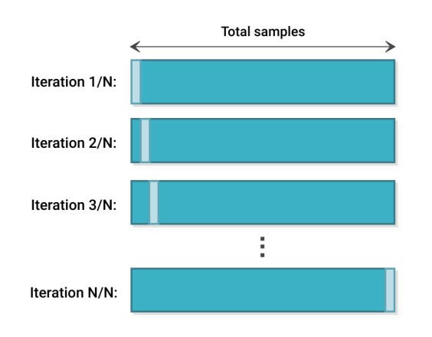
Dataset
To assess the performance of our model, we employ the leave-one-out cross-validation (LOOCV) technique.
Given that we have a total of 30 horses, we will train the model 30 times. Each time, we will exclude all frames from the videos of one specific horse as a test set for external validation. For the remaining frames, we randomly select 3 horses as a validation set, while the remaining 26 horses' frames are used for training.
The predictions are generated on a per-frame basis, so for every video in the dataset, we adopt a majority voting approach
to determine the overall prediction for that video.
We can also use the average confidence level approach.

Slide 21
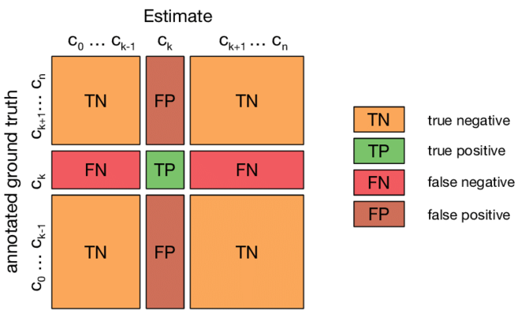
Evaluating Our Model
Given a set of predictions and the actual values (ground truth), let TP be the number of True Positives, FP the number of False Positives, TN be the number of True Negatives, and FN be the number of False Negatives.
The evaluation metrices are computed as follows:
Accuracy: the proportion of correct predictions among all predictions (TP+TN / TP+TN+FP+FN).
Precision: the proportion of true positive predictions among all positive predictions (TP / TP+FP).
Recall (sensitivity, true positive rate): the proportion of true positive predictions among all actual positive values (TP / TP+FN).
F1 score: the harmonic mean of precision and recall (2(precisionrecall) / (precision+recall)).
Note that all the metrices will be evaluated video-wise (per video, not frame).
Additionally, we will examine the confusion matrix to explore the
possibility of consolidating the negative emotions
in order to improve accuracy.

Slide 22

Relevant Code
Our GitHub Repository: https://github.com/HanaHasan04/FinalProject_2023.git
We have uploaded the following scripts:
Breaking videos into frames
YOLO face cropping
Center cropping
Keras classifier
LOOCV split
PyTorch classifier
Training a Mask-RCNN (template)
Vector embeddings from the CLIP image encoder

Slide 23


